Slide 1
A C Circuits (3rd Rank)
Prepared By- Guided By-
BHIMANI VIVEK (131090109007) Mr. Mayank C Valani
CHAUHAN CHIRAG (131090109008)
CHOPDA CHETAN (131090109009)
CHUDASAMA BHAVIK (131090109010)
DHARAVIYA ASHISH (131090109011)
JADAV VIRENDRA (131090109012)

Slide 2
Topics of chapter
Generation Of Alternating Voltages & currents :- Equations, Definitions, R.M.S. And Average Values.
Vector Representation :- Addition And Subtraction
Complex Algebra
Phasor Relations
A.C. Series And Parallel Circuits
Power And Power Factor
Circuit solution methods
Resonance

Slide 3
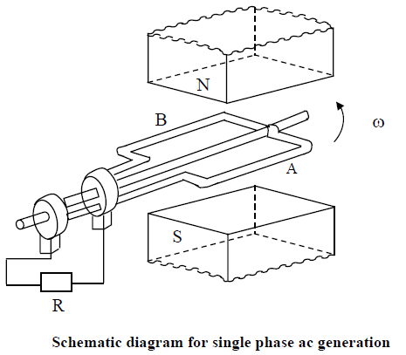
Generation Of Alternating Voltages

Slide 4
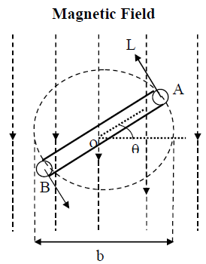
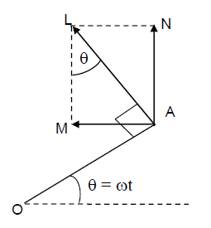
Coil Position

Slide 5
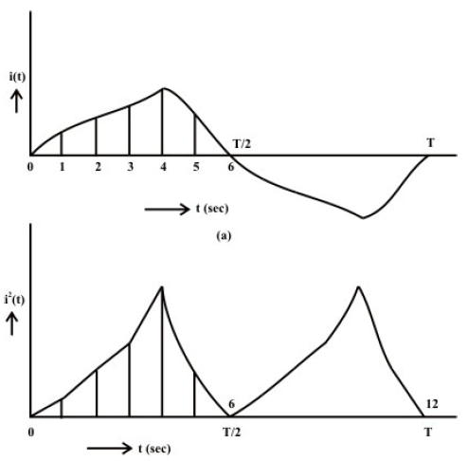
Average value
Periodic current Waveforms

Slide 6
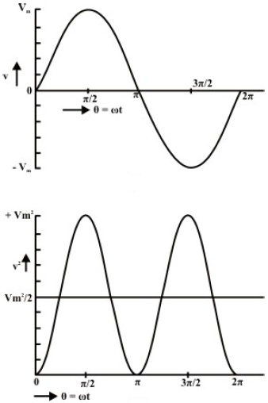
rms Sinusoidal voltage waveforms

Slide 7
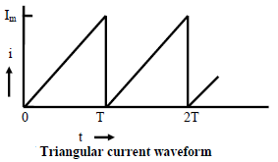
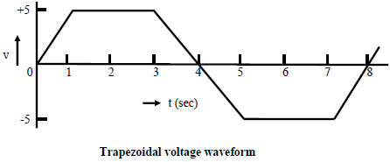

Slide 8
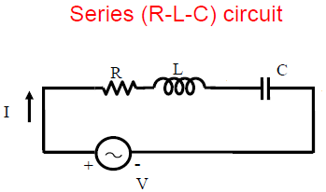

Slide 9
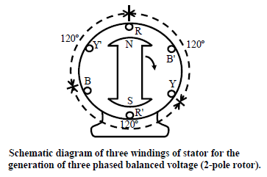
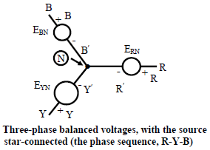
Three-phase AC circuits

Slide 10
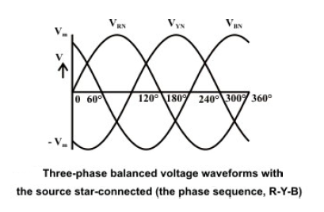
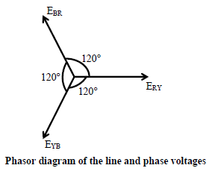

Slide 11
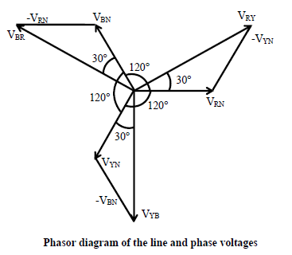

Slide 12
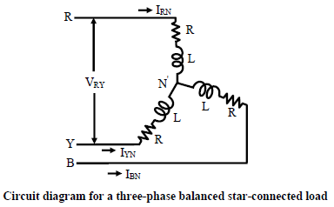
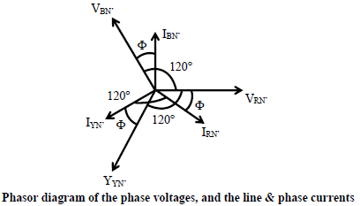

Slide 13
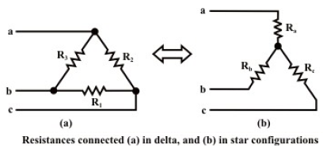
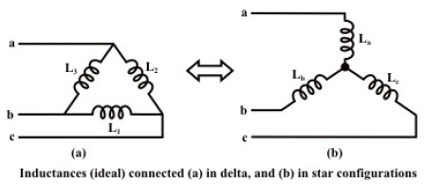

Slide 14
Thank You!!!!

